Slide 1
University American College Skopje
Course: Business Computer Applications
Essential PowerPoint features
Marija Stanojeska, PhD

Slide 2

Based on the textbook:
Microsoft Office Inside Out (Office 2021 and Microsoft 365), J. Habraken, Pearson Education, Inc., 2022.

Slide 3
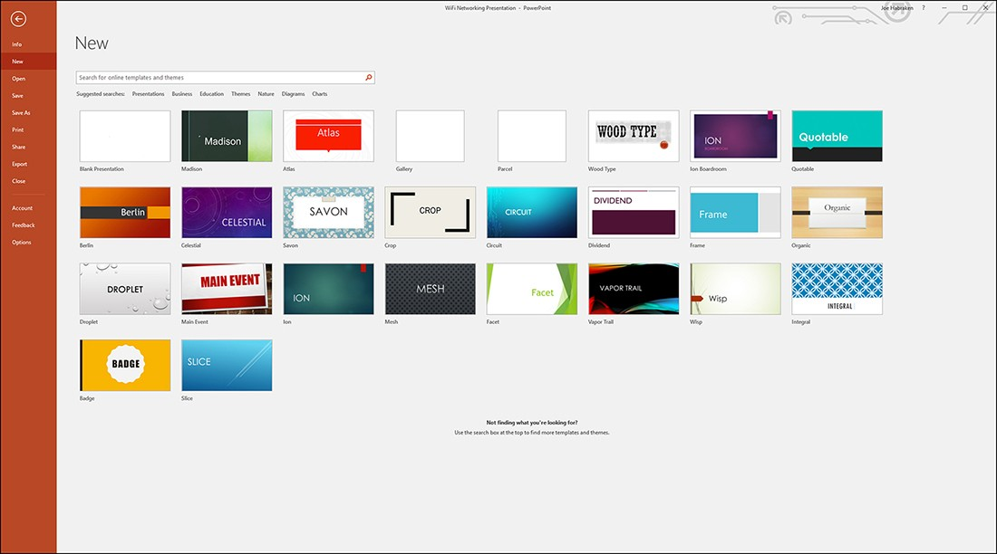
The new page in the PowerPoint backstage
To access the New page from the PowerPoint application window, select File on the ribbon and then select New. Note that the New page provides the same capabilities as the Start screen in terms of accessing presentation templates and themes.

Slide 4
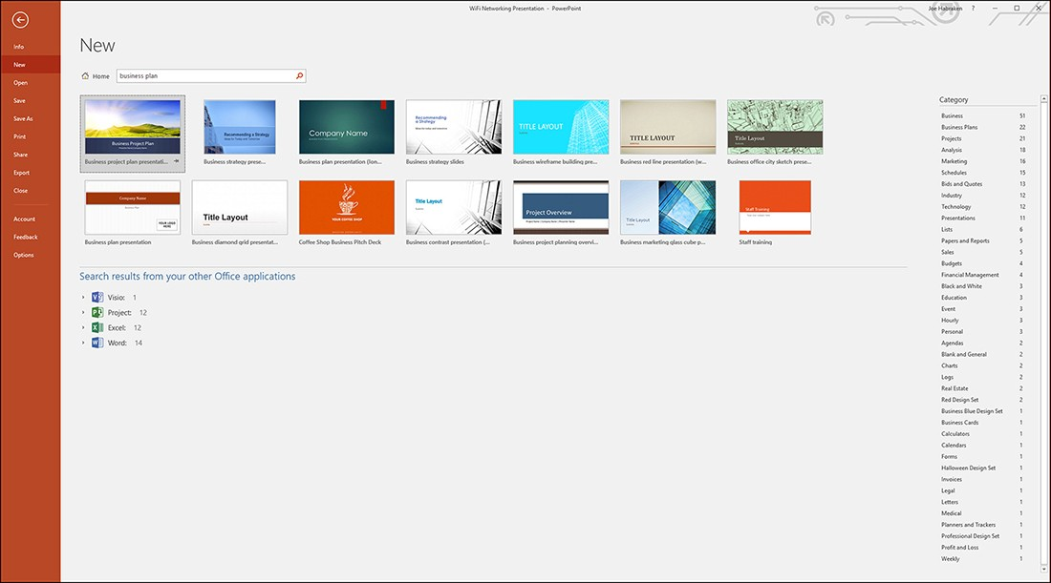
Online PowerPoint templates
You can search for online templates using the Search box on either the Start screen or the New page.

Slide 5
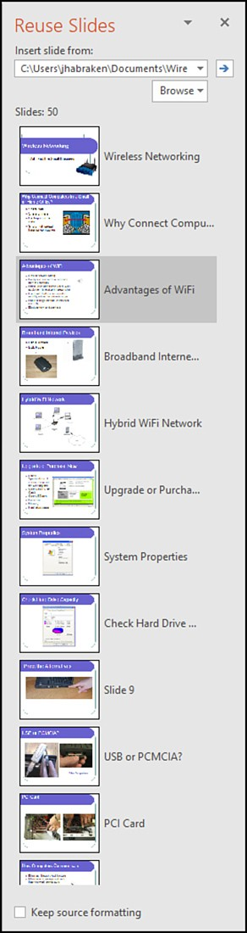
Inserting slides from the Reuse slides task pane
PowerPoint also makes it easy for you to insert slides from an existing presentation into your current presentation. The Reuse Slides task pane enables you to use any or all slides in an existing presentation. To insert existing slides into your current presentation, follow these steps:
On the ribbon’s Home tab, select the New Slide command and then select Reuse Slides.
In the Reuse Slides task pane, click the Open A PowerPoint File link.
Locate the PowerPoint presentation that supplies the slides for the current presentation. Click Open.
To add a slide from the Reuse Slides task pane to the current presentation, select a slide.

Slide 6
Entering text
Each new slide has at least a title text box and a content area box. The default formatting for content text is a bulleted list.
PowerPoint provides an alternative to entering text on each slide in the Slide pane. You can switch to Outline view and enter slide text in an outline format. You can also add new slides when you are working in Outline view. To switch to Outline view, click the ribbon’s View tab and then select Outline View.
View > Outline View
Each slide in the presentation is represented in the outline as a primary heading.
The text used is the title text for the slide. To add text to a slide (such as a bulleted list below a slide heading), click below the heading (in the outline) and then enter the text.
You can easily rearrange the text on your slides using Outline view. For example, you can drag an entire bulleted list from one slide to another in Outline view. You can also move items around in Outline view as needed to organize the presentation. When you want to return to Normal view, select Normal on the View tab or click the Normal icon on the right side of the PowerPoint status bar.

Slide 7
Working with slides in diﬀerent views
The views provided on the ribbon’s View tab (in the Presentation Views group) follow:
Normal: This is the default view, which includes the Slide pane, the Notes pane, and a navigation pane that includes thumbnails of all the slides in the presentation.
Outline View: This view enables you to view the slides in an outline format that concentrates on the text on each slide. You can add new slides directly to the outline and add slide text at diﬀerent levels in the outline. Tab and Shift+Tab are used to move up and down a level in the outline, respectively.
Slide Sorter View: This view shows all the slides as thumbnails so that you can easily rearrange them by dragging slides to new positions in the presentation.
Reading View: This view plays the presentation as a slideshow. This enables you to view the presentation and work with another application on the Windows desktop. You can go back to the previous view (from Reading view) by pressing the Esc key.
Notes Page View: This view enables you to see the current slide and its accompanying notes page. This view is designed for you to enter and review the speaker notes that you are creating to go with each slide in the presentation.

Slide 8
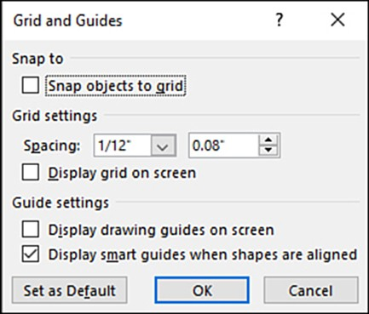
Rulers, gridlines, and guides
PowerPoint provides visual guides that help you better arrange objects on your slides. Home > View
Smart guides - appear automatically when you move an object on a slide (a text box, picture, chart, or any object). The best way to experience the smart guides is to place some objects on a slide and then drag them around to see what happens.
Ruler check box - view the horizontal and vertical rulers. When the rulers are placed in the workspace, the horizontal and vertical positions of the mouse pointer are shown as tick marks on the horizontal and vertical rulers as you move the mouse around the slide.
Gridlines check box - aligning objects on the slide. The gridlines are nonprinting horizontal and vertical lines.

Slide 9
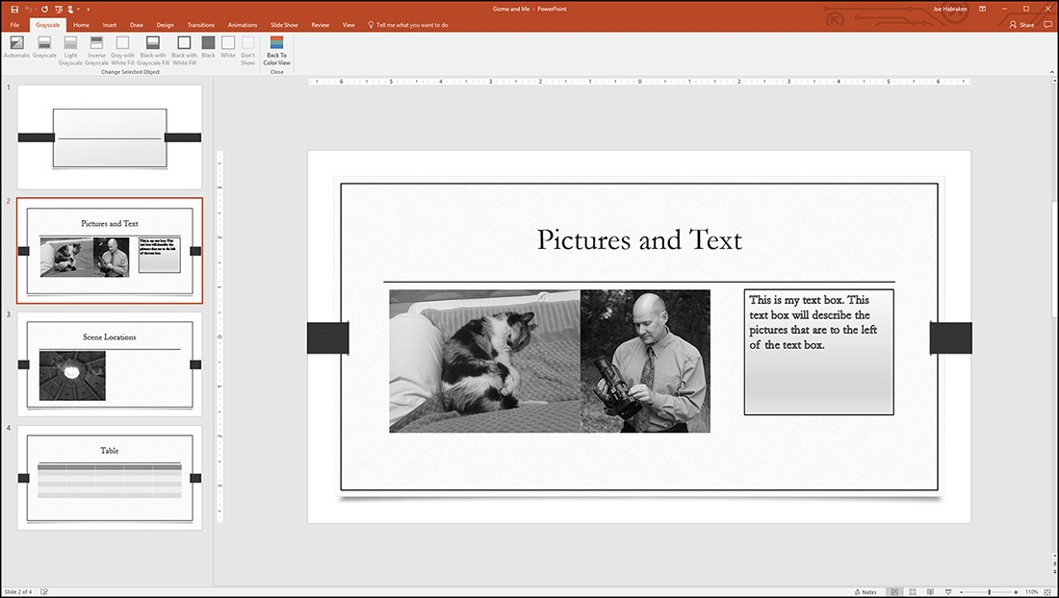
Color/grayscale commands
By default, your presentation slides are shown in color. The Color command is selected in the Color/Grayscale group.
You can view your presentation in grayscale or black and white and then customize how the various colors are translated to grayscale or black and white. To view the slides in grayscale or black and white, select either the Grayscale command or the Black and White command. You switch to Grayscale or Black and White view, and the ribbon shows the Grayscale or Black and White tab.
Home > View > Grayscale

Slide 10
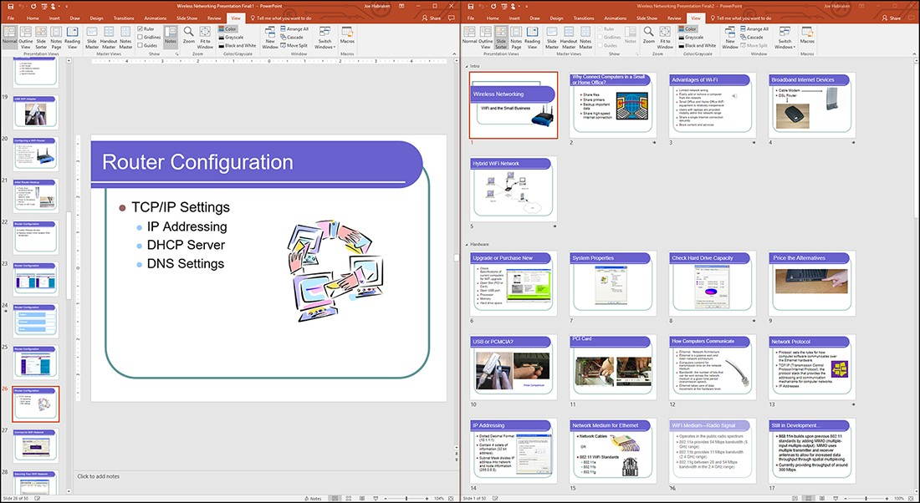
Opening a new presentation window
To open a second presentation window, select the ribbon’s View tab and then select the New Window command. A second window containing the current presentation opens on the Windows desktop. To arrange the two open presentation windows side by side, select the Arrange All command. Normal view is used in the left window, and Slide Sorter view is used in the right window.
View > New Window > Arrange All > Normal View

Slide 11
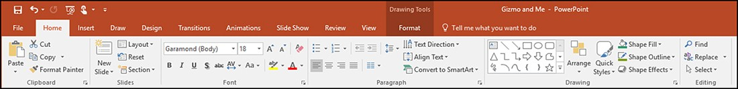
Basic text formatting
The typical formatting commands for both the font and paragraph attributes of the text in a text box are provided in the Font and Paragraph groups on the Home tab. The Font group provides control over the font type, size, color, and other attributes such as bold, italic, and underline. The Paragraph group enables you to change the horizontal alignment of the text, create bulleted and numbered lists, change the line spacing, and indent text. Figure shows the Home tab, including the Font and Paragraph groups.

Slide 12
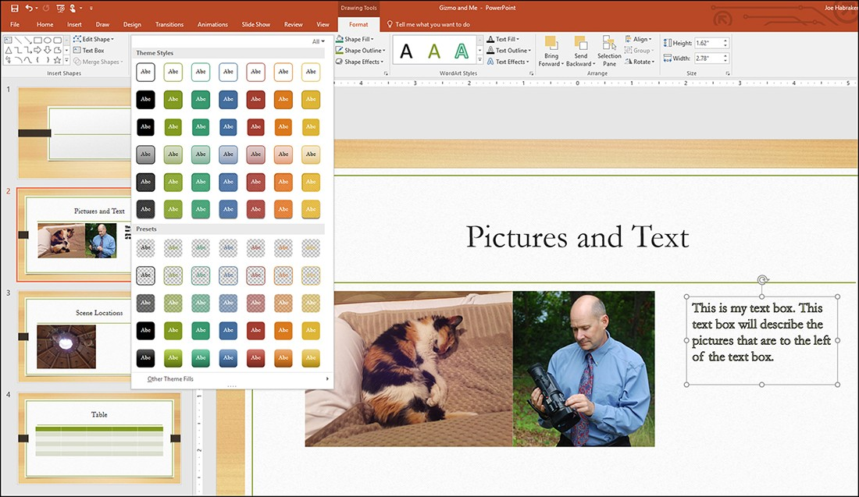
Selecting quick styles and shape attributes
Shape styles (or quick styles, as they are also referred to) are sets of formatting attributes that aﬀect the Text Box Border, Font Color (and Bullet Color if applicable), and Text Box Background (Fill) Color.
The shape styles are housed in the Shape Styles gallery. You can use the scroll arrows to scroll through the styles provided, or you can click the More button to view the entire gallery.
Select text > Home > Format click on Quick Styles

Slide 13
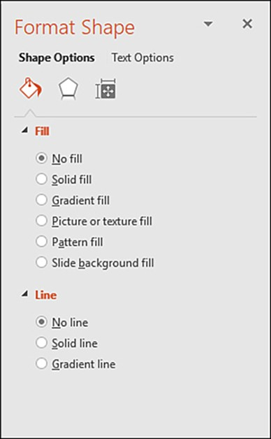
Fine-tuning shape formatting
The Shape Styles group commands take care of most of the possibilities in formatting the appearance of a text box.
If you want to ﬁne-tune the format settings for a text box or other object, you can use the Format Shape task pane.
Select text > Format > Click on the right bottom arrow and select Shape

Slide 14
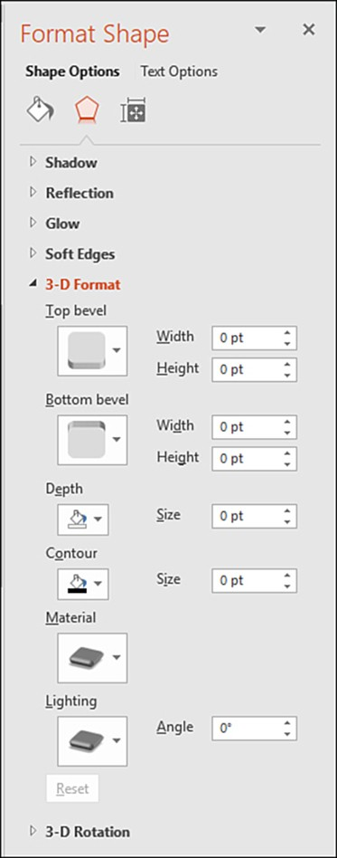
Fine-tuning shape formatting (cont.)
When you select the Eﬀects icon at the top of the Format Shape task pane, you are provided with access to all the diﬀerent shape eﬀect possibilities. Most of these eﬀects, such as Shadow, Reﬂection, and Glow, provide access to several presets but also provide you with the ability to set custom sizes, colors, and the transparency level.
Select text > Format > Click on the right bottom arrow and select Options

Slide 15
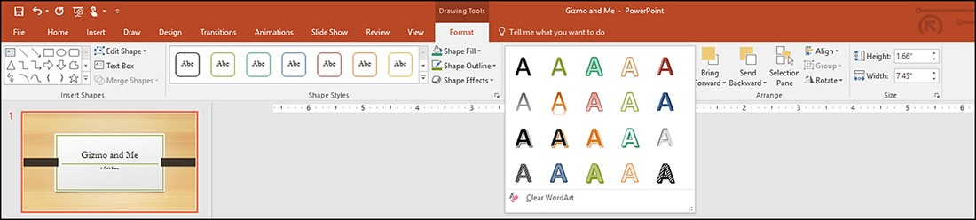
Using WordArt styles and text settings
To take advantage of the WordArt Styles gallery select the WordArt Styles drop-down arrow on the Drawing Tools Format tab. You can then scroll through the possibilities provided in the gallery. If you want to see the entire gallery, click the More button.
Select text box > Click on Format tab > Select WordArt Styles

Slide 16
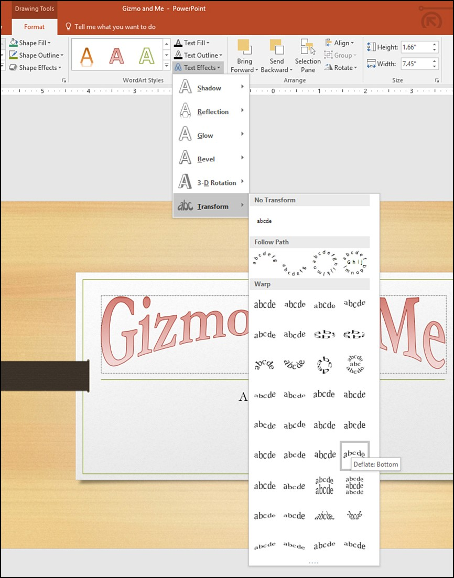
Text ﬁll, outline, and eﬀects
The Text Eﬀects command enables user to select from a number of diﬀerent eﬀects galleries, including Shadow, Reﬂection, Glow, and Transform. Select a category such as Transform and then preview the possibilities provided in a speciﬁc gallery.
Figure shows the Transform gallery provided by the Text Eﬀects command.
Select text box > Click on Format tab > Text Effects > Transform

Slide 17
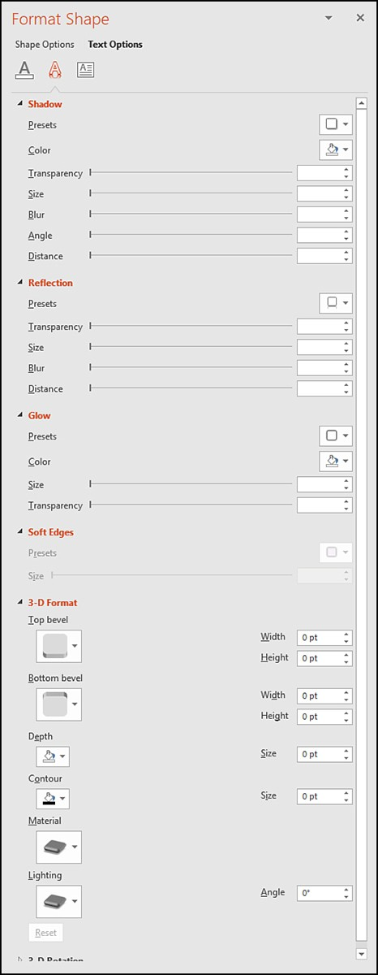
Setting text eﬀects in the Format Shape task pane
Figure shows the Format Shape task pane with the Text Eﬀects icon selected.
As with the Shape Options we discussed in the previous section, expand one of the settings groups, such as Shadow, Reﬂection, or Glow, and then change the settings as needed.
The Text Eﬀect settings (Shadow through 3D Rotation) work exactly the same as the eﬀect settings we discussed for formatting shapes.
Click on the Text Box > Format in Drawing > click on the right arrow > Select Options

Slide 18
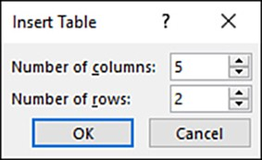
Arranging text in tables
The easiest way to create a table on a slide is to create a new slide that uses the Title and Content layout (or use any slide with a content option); insert the new slide using the New Slide command on the Home tab. In the content area of the slide, select the Insert Table icon. The Insert Table dialog box opens. Specify the number of columns and the number of rows for the new table using the spin boxes provided. When you are ready to place the table on the slide, click OK.
Insert > Table > Insert Table

Slide 19
Table layout commands
The Layout commands appear on the Table Tools, Layout tab. These tools range from commands that enable you to insert columns and rows, merge and split cells, and change the text alignment in a cell or cells. The Layout tab houses several command groups that enable you to manipulate your rows, columns, and cells and work with the text alignment within the cell. Figure shows the Table Tools, Layout commands.
Click on the Table > Insert > Layout

Slide 20
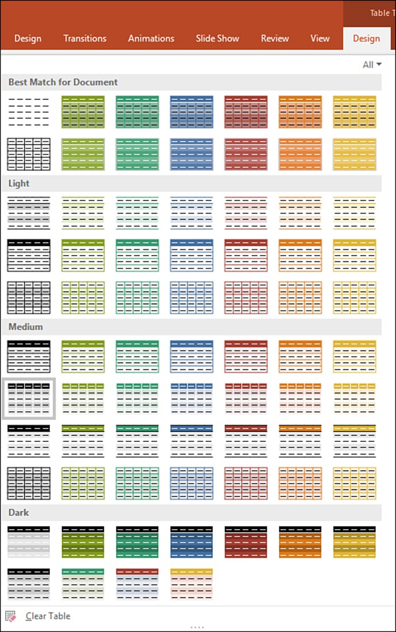
Table design commands
The Table Tools Design tab provides commands that enable you to quickly format the table, including its shading and borders.
Commands are also available that enable you to apply quick styles and other WordArt formatting to the text within the table cells.
Click on the Table > Insert > Design

Slide 21
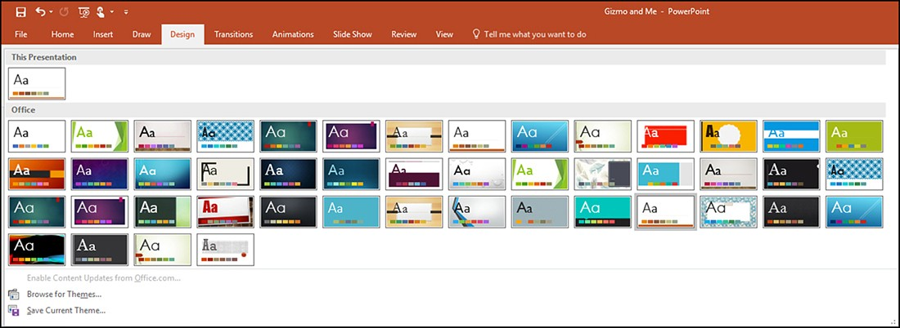
Applying themes
A theme can be applied to your current presentation by selecting a theme in the Themes gallery. The Themes gallery is on the ribbon’s Design tab. To preview a theme on the current presentation, place the mouse on a particular theme. Users also have the option of modifying the colors, fonts, eﬀects, and background settings for a theme (and any of its variants). Changes that users make to a theme or one of its variants can be saved as a custom theme.

Slide 22
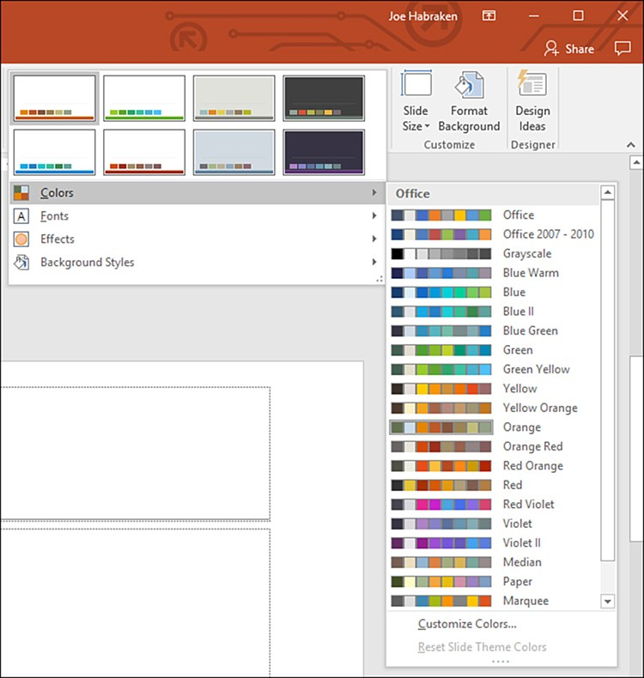
Applying theme variants
PowerPoint makes it easy for you to apply diﬀerent color schemes and backgrounds to your presentation slides using themes. Each speciﬁc theme also has variants, which are variations on the selected theme. Variants of a theme are accessed via the Variants gallery.
Design > Variants > Click on the right arrow > Select colors gallery

Slide 23
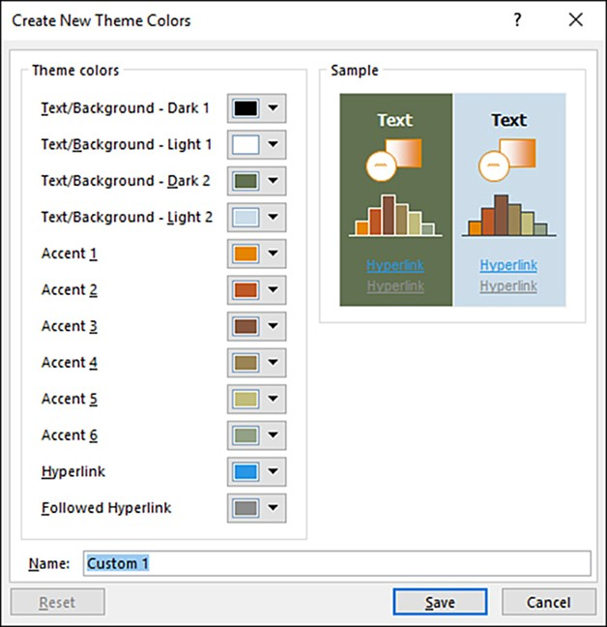
Theme colors
If you want to create your own theme colors, you can do so in the Create New Theme Colors dialog box. To open this dialog box, select Customize Colors in the Colors gallery. Use the various color drop-down palettes to select the speciﬁc colors for the theme color set. When selecting a color, you can use theme colors or standard colors.
Design > Variants > Click on the right arrow > Select colors gallery > Customize colors

Slide 24
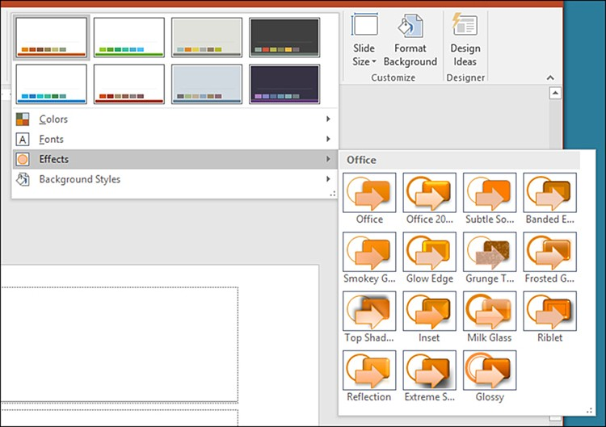
Theme effects
Theme eﬀects can also be modiﬁed for the current theme or variant by selecting a built-in eﬀects set from the Eﬀects gallery. Expand the Variants gallery and then select the Eﬀects command.
Design > Variants > Click on the right arrow > Select Effects

Slide 25
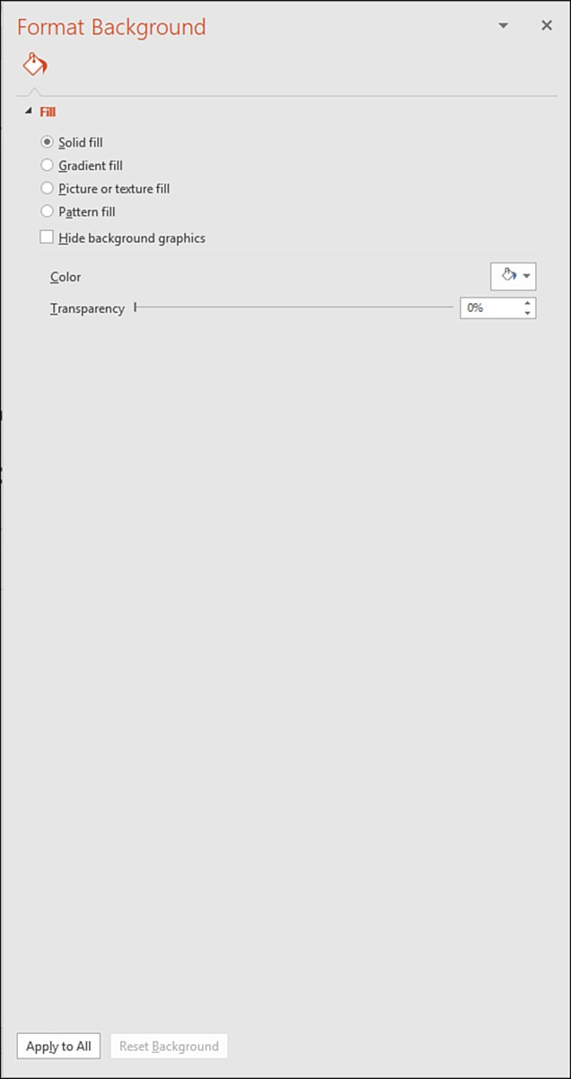
Theme backgrounds
PowerPoint provides options for changing the background on all the slides in the presentation or speciﬁc slides in the presentation. Expand the Variants gallery and then select Background Styles. Select a background style from the gallery.
You can also format the background manually using the Format Background task pane.
You can open the Format Background task pane by selecting Format Background in the Background Styles gallery or by selecting the Format Background command in the Customize group on the ribbon’s Design tab.
Design > Format Background

Slide 26
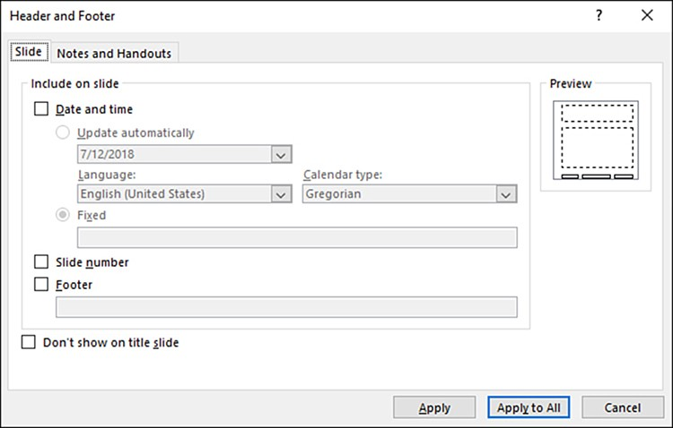
Using headers and footers
Each slide in your presentation will be unique in terms of the slide’s content. There will be occasions when you want to add repeating information to every slide in the presentation. In PowerPoint, repeating information placed on your slides is housed in the footer, which means the repeating information will appear at the bottom of each slide.
Insert > Header & Footer

Slide 27
Using headers and footers
Each slide in your presentation will be unique in terms of the slide’s content. There will be occasions when you want to add repeating information to every slide in the presentation. In PowerPoint, repeating information placed on your slides is housed in the footer, which means the repeating information will appear at the bottom of each slide.
Insert > Header & Footer

Slide 28
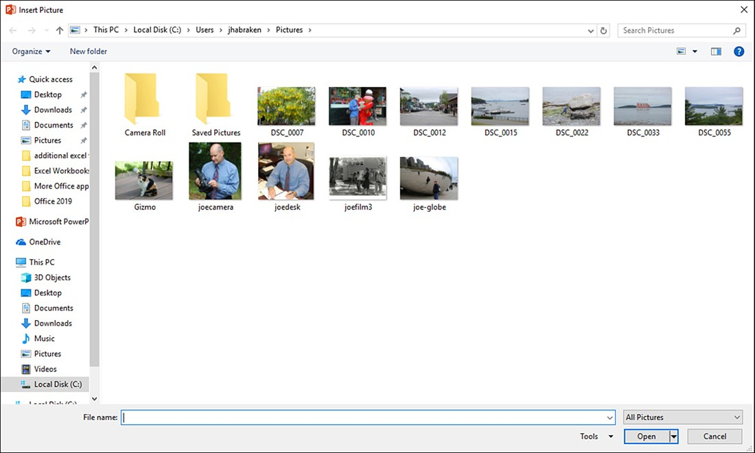
Inserting a picture
You can quickly insert a picture ﬁle that you have stored on your computer using the Pictures command in the Images group. The default location for the Insert Picture dialog box is the Pictures library.
Insert > Pictures window

Slide 29
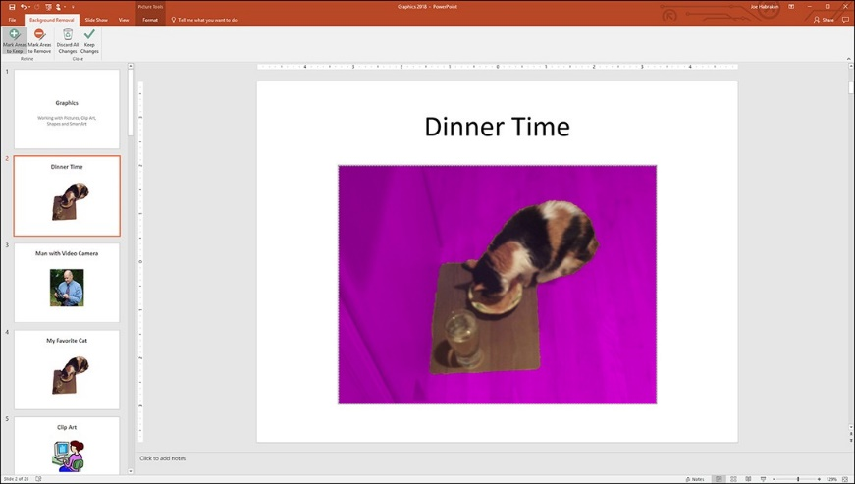
Inserting a picture
When the picture is selected on the slide, the Picture Tools, Format tab appears on the ribbon.
Click on the picture > Format tab
The Picture Tools groups are as follows:
Remove Background
Adjust
Picture Styles
Arrange
Size

Slide 30
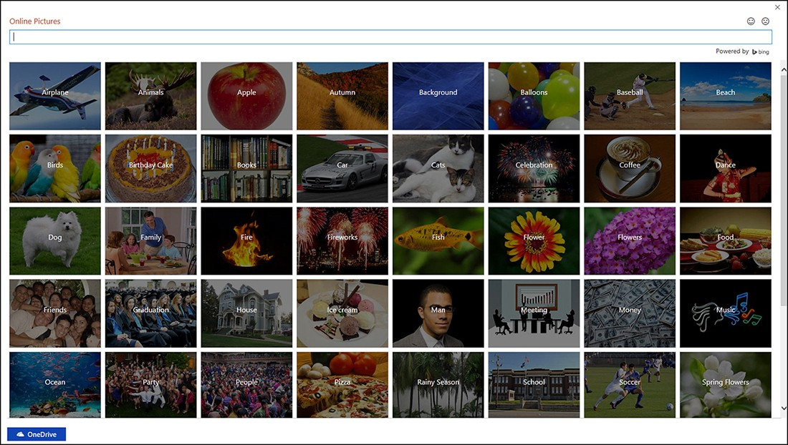
Adding online images to slides
When you open the Online Pictures window, you use the Bing search engine to do an image search (by keyword) on the web. To open the Online Pictures window, select the Online Pictures command in the Images group. By default, the Bing image search shows only images that match your search criteria and are licensed under Creative Commons.
Insert > Online Pictures window

Slide 31
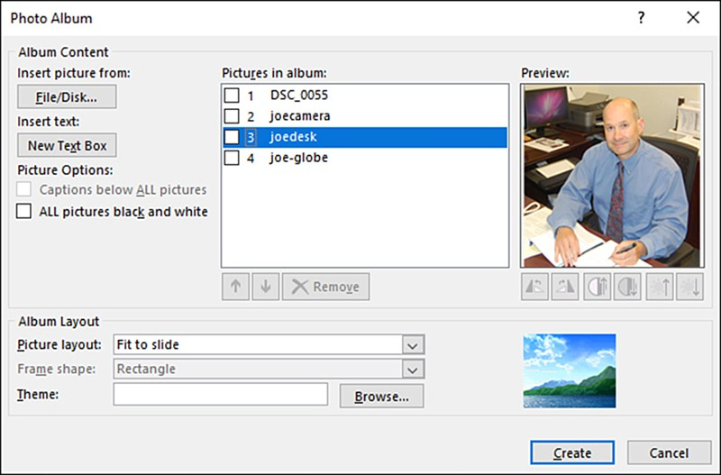
Creating a photo album
The Photo Album command is on the Insert tab in the Images group. When you use the Photo Album command, a new presentation is created, including a title slide for the presentation. Because a new presentation is created for the photo album, the slides in the current presentation are not disturbed. To create a new photo album, select Photo Album on the Insert tab and then select New Photo Album. The Photo Album dialog box opens. The ﬁrst step in the process of creating the photo album is to specify the pictures to include in the album. Select the File/Disk command, and the Insert New Pictures dialog box opens. This dialog box opens to the Pictures library by default. Locate the pictures that you want to use for the photo album. It makes sense to select as many of the pictures as you can at this point.
Insert > Photo Album > New Photo Album

Slide 32
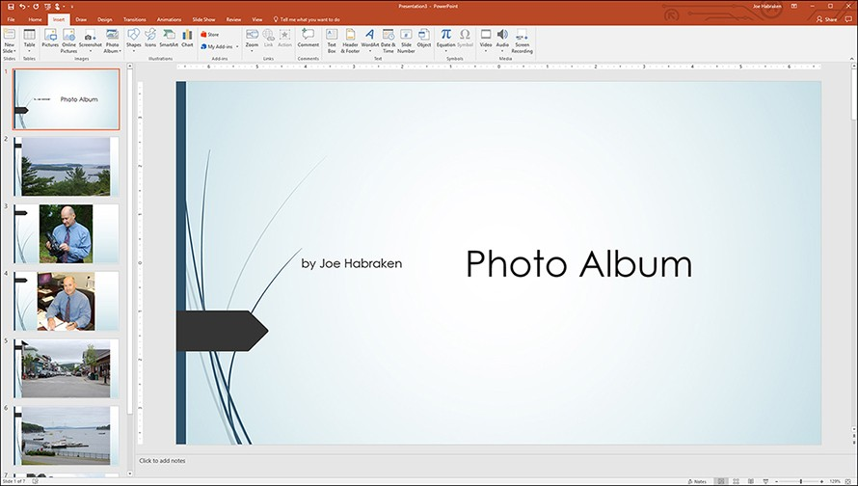
Conﬁguring album layout settings
The Picture Layout drop-down menu does give you other options for how the pictures appear on the slides. These settings also enable you to specify the frame shape for the picture by selecting a shape from the Frame Shape drop-down list. A number of frame shapes are available, including Rounded Rectangle, Simple Frame, White, Center Shadow Rectangle, and Soft Edge Rectangle. Options for two and four pictures with a title are also included in the Picture Layout drop-down menu. Both the number of slides you specify in the layout and the frame shape you select are previewed in the Album Layout area of the Photo Album dialog box. You can then take advantage of the Themes gallery and the Pictures Style gallery, which both provide visual examples of the themes and styles available.

Slide 33
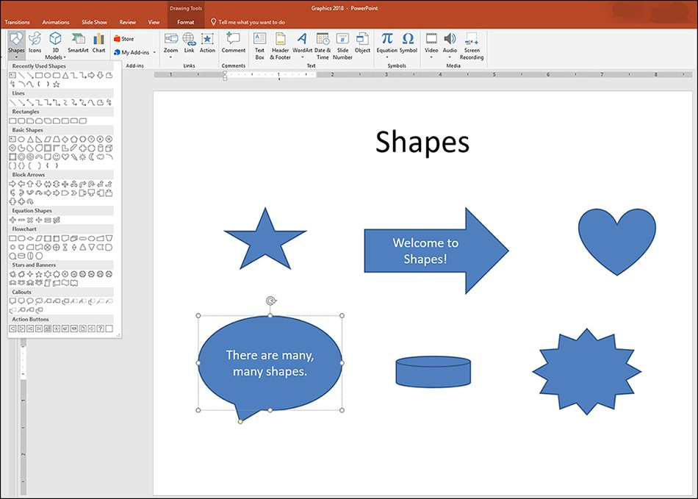
Working with shapes
To insert a shape, select the Shapes command on the ribbon’s Insert tab. The shapes provided in the gallery are divided into categories, including lines, rectangles, block arrows, and callouts, just to name a few. When you have located the shape that you want to use, click it. A drawing tool replaces the mouse pointer. Drag on the slide to draw the shape. You can size and position the shape on the page as needed.

Slide 34
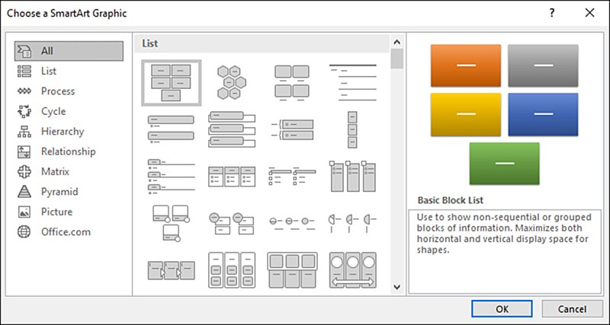
Using SmartArt graphics
PowerPoint provides diﬀerent types or categories of SmartArt, with each type having a particular purpose. For example, the Cycle category creates diagrams that represent sequential cycles or a process that takes place in a circular ﬂow.
Insert > SmartArt

Slide 35
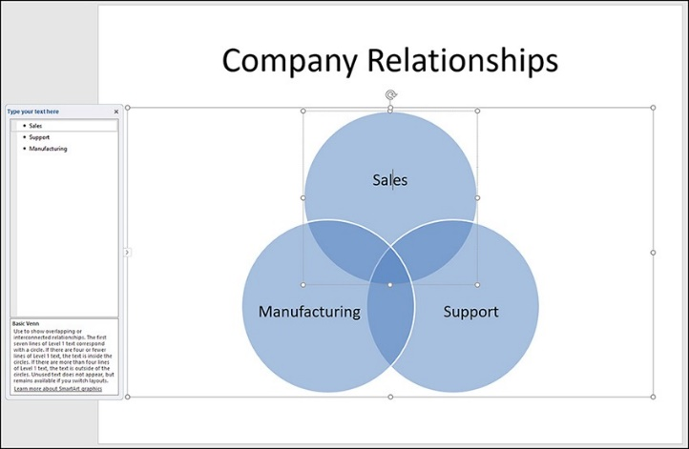
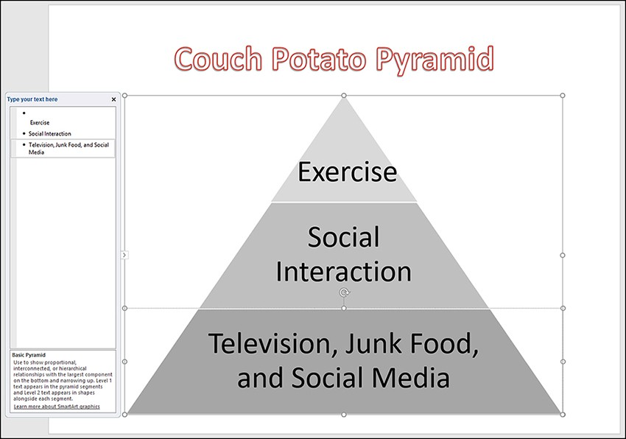
Using SmartArt graphics (cont.)
PowerPoint provides diﬀerent types or categories of SmartArt, with each type having a particular purpose. For example, the Cycle category creates diagrams that represent sequential cycles or a process that takes place in a circular ﬂow.
The SmartArt categories:
List
Process
Cycle
Hierarchy
Relationship
Matrix
Pyramid
Picture
Office.com

Slide 36
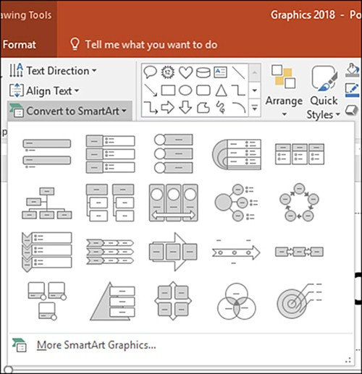
Converting text to a SmartArt graphic
To convert text to a SmartArt graphic:
Select the text box that contains the text you want to convert. This can be any text box on a slide, including bulleted and numbered lists.
On the Home tab, select the Convert To SmartArt command in the Paragraph group. The SmartArt gallery opens, providing a subset of the available SmartArt graphics.
Select a graphic from the gallery or access more graphics by selecting More SmartArt Graphics and selecting a graphic. This opens the Choose a SmartArt Graphic dialog box.
If you select a diagram in the gallery, the text in the text box is immediately converted. To do the conversion from the Choose A SmartArt Graphic dialog box, select a graphic and then click OK.

Slide 37
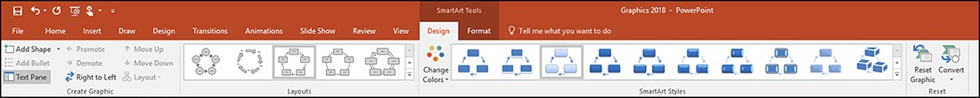
Using the SmartArt tools – Design tab
When the diagram is on the slide and selected, the SmartArt Tools appear on the ribbon. Two diﬀerent tabs of SmartArt Tools appear: Design and Format.
The SmartArt tools, Design tab
The Design tab provides commands that enable you to manipulate the number and position of individual graphics in the diagram and to change the layout and style of the SmartArt graphic. Figure shows a Block Cycle SmartArt graphic and the Design tab commands. The command groups on the Design tab are as follows:
Create Graphic
Layouts
SmartArt Styles
Reset
Click on the shape > Design

Slide 38
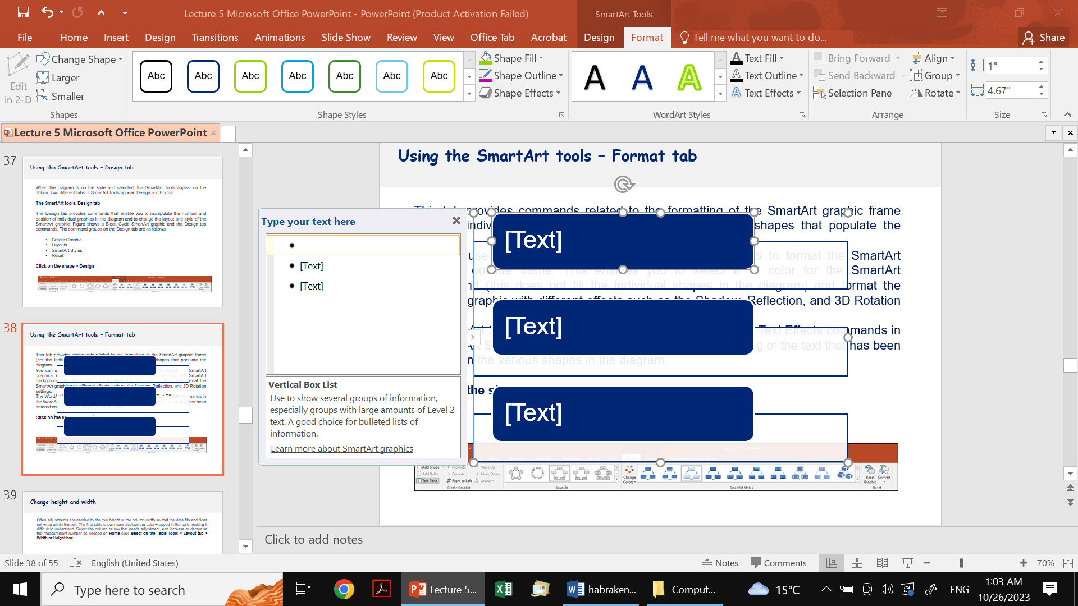
Using the SmartArt tools – Format tab
This tab provides commands related to the formatting of the SmartArt graphic frame (not the individual items) and the text within the various shapes that populate the diagram.
You can use Shape Fill, Shape Outline, and Shape Eﬀects to format the SmartArt graphic’s outside frame. This enables you to select a ﬁll color for the SmartArt background (this does not ﬁll the individual shapes in the diagram) and format the SmartArt graphic with diﬀerent eﬀects such as the Shadow, Reﬂection, and 3D Rotation settings.
The WordArt Styles gallery and the Text Fill, Text Outline, and Text Eﬀects commands in the WordArt Styles group can be used to change the formatting of the text that has been entered on the various shapes in the diagram.
Click on the shape > Format

Slide 39
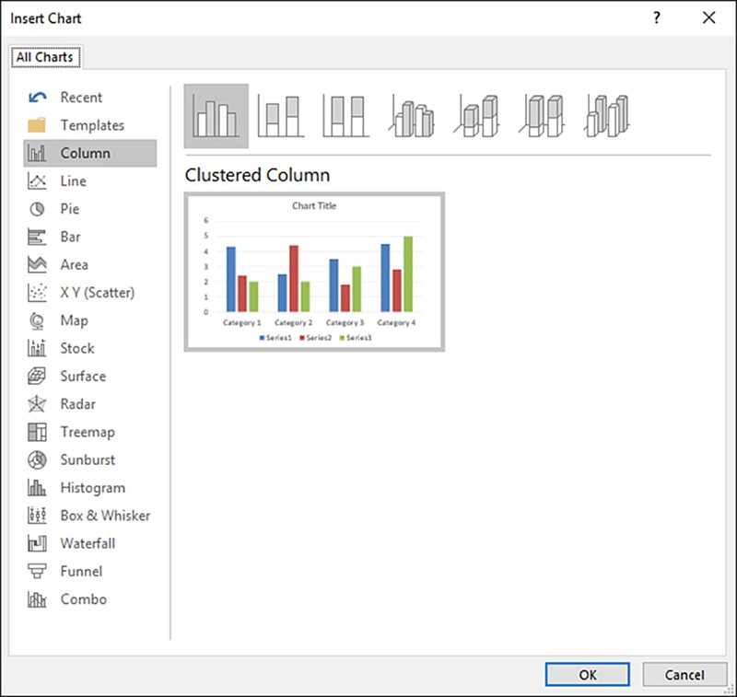
Inserting a chart onto a slide
You can insert a chart using the Chart command on the ribbon’s Insert tab, or you can select the Insert Chart icon in a content box. Select a particular chart type, such as Column or Pie. Note that each chart type also provides diﬀerent formats.
The column chart type can be inserted into diﬀerent formats, including a clustered column, stacked column, and clustered cylinder.
The pie chart formats include a 3D pie and an exploded pie. Select the format type for the selected chart type (chart types are along the top of the dialog box), and then click OK.

Slide 40
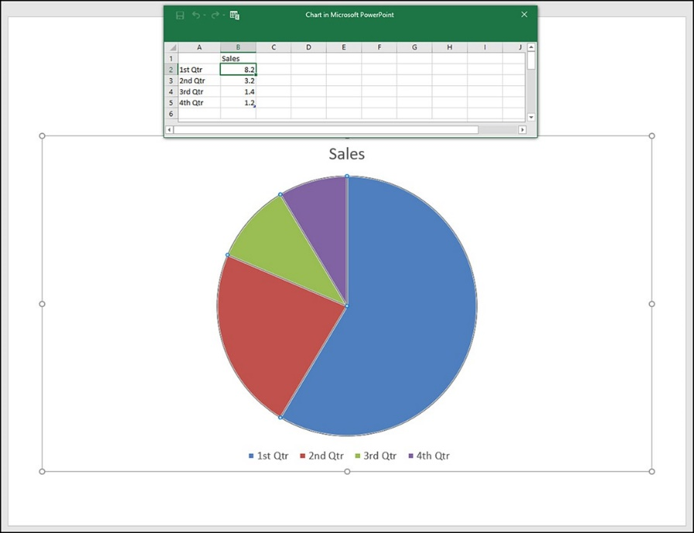
Inserting a chart onto a slide (cont.)
At this point, the chart doesn’t reﬂect your data or text labels. You need to modify the labels (text entries) and the numerical data on the worksheet. When you do so, the chart immediately reﬂects the new data.
Click in the appropriate cells on the worksheet and enter your text labels and data as needed. If you need to add more data points than those provided, you can drag the data range border (the lower-right corner) to extend the data range and enter more labels and numerical information.

Slide 41
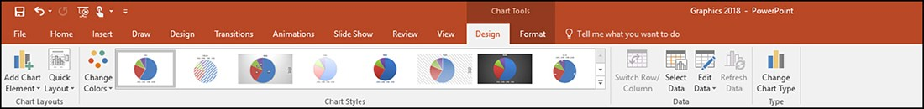
Modifying a chart’s design using the Design tab commands
The various commands provided by this contextual ribbon addition are divided between two tabs: Design and Format. The Design tab provides commands related to the chart’s type and layout and gives you the ability to edit the data used to create the chart. The Change Chart Type command enables you to change the current chart to another type. If you then need to edit the data for the chart, select the Edit Data command. This tab also provides a Quick Layouts gallery, which enables you to adjust the overall layout of the chart.
Each chart type has speciﬁc layouts available. You can change the style of the chart by taking advantage of the Chart Styles gallery.

Slide 42
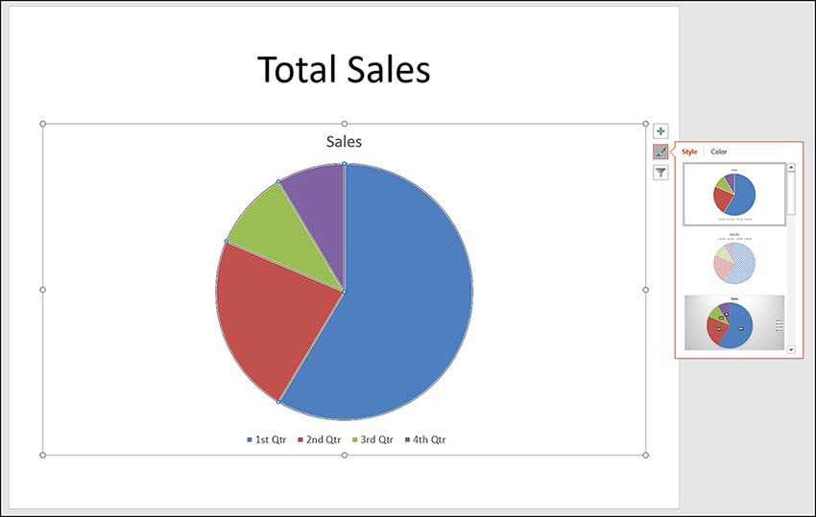
Modifying a chart’s design using the Design tab commands
The Format tab grants access to Shape styles to modify the frame of the chart; you can also change the ﬁll, outline, and eﬀects for the chart frame. When you select text objects on the chart, such as the title or legend, you can take advantage of the WordArt Styles gallery and the other text settings on this tab. This tab also enables you to add shapes to the chart and arrange objects in the frame.
PowerPoint provides inline command buttons that enable you to manipulate chart elements, change the chart style, and ﬁlter the data sets on your chart. When the chart frame is selected, these command buttons appear on the right side of the slide.

Slide 43
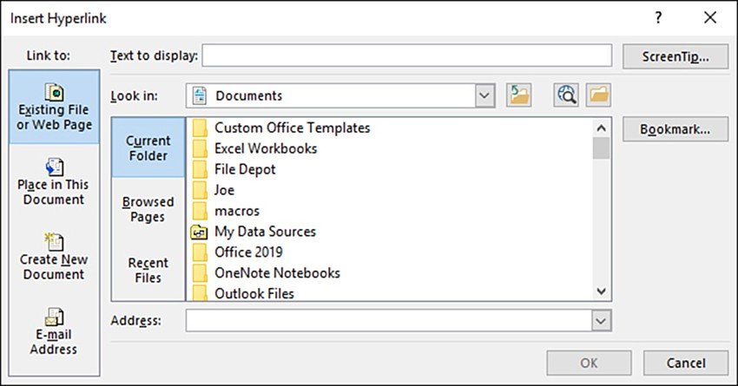
Adding hyperlinks to slides
Hyperlinks are added to a text box on a slide using the Insert Hyperlink dialog box. By default, the Existing File Or Web Page setting is selected in the Link To box. This setting enables you to create a hyperlink to a ﬁle on your computer or a web page. By default, the contents of the My Documents folder are displayed in the Insert Hyperlink dialog box. If the hyperlink is to an existing ﬁle, you can select any document in the folder or navigate to another folder to specify an existing ﬁle.
Insert > Hyperlink

Slide 44
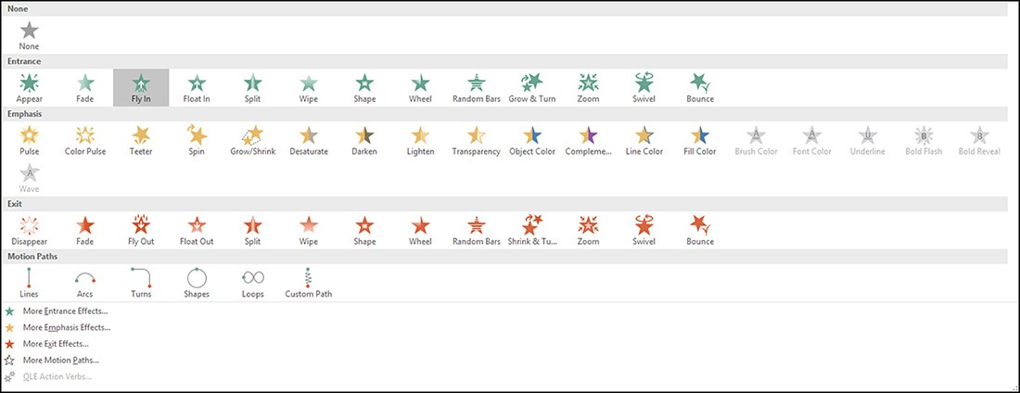
Assigning animation to a slide object
Animating an object (or objects) on a slide is an easy three-step process.
Select an object on the slide
Select an animation from the Animation gallery
Use the Eﬀect Options gallery to ﬁne-tune the selected animation

Slide 45
Linking to a place in a document
The Animation gallery groups the animation eﬀects into four categories:
Entrance group- provides animations that dictate how the object enters the slide when the animation plays.
Emphasis category - provides animations that enable you to emphasize objects such as the items in a bulleted list (as you talk about a particular item in the list, you can click the mouse so that the bulleted item is emphasized with a pulse or spin).
Exit category - provides animations that remove items from the slide (if you assign an exit animation such as the Fade eﬀect, the items in the bulleted list fade (sequentially) each time you click the mouse.
Motion path category – determines the pattern for a slide object’s entry and its path on a slide.
To assign an animation eﬀect to an object or objects on a slide, follow these steps:
Select the object or objects on the slide.
Select the Animations tab on the ribbon.
Place the mouse on an animation in the Animation gallery to preview the animation on the slide object.
Select the animation you want to use to close the gallery and assign the animation to the slide object.
The Preview button on the Animations tab gives you a preview of the animation eﬀect or eﬀects in Normal view.

Slide 46
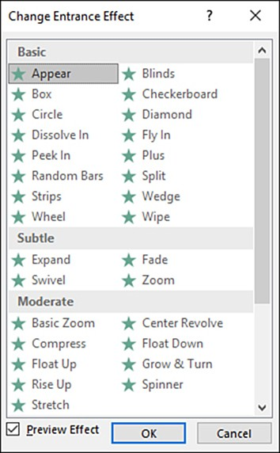
Accessing additional animation eﬀects
You can access additional animation eﬀects via a set of dialog boxes that open from the Animation gallery.
Each animation eﬀect type has a separate dialog box.
For example, the Change Entrance Eﬀect dialog box, shown in Figure below.
The entrance eﬀects in the Change Entrance Eﬀect dialog box are grouped into categories titled Basic, Subtle, Moderate, and Exciting.
Animation > Select category > Select more Entrance Effect

Slide 47
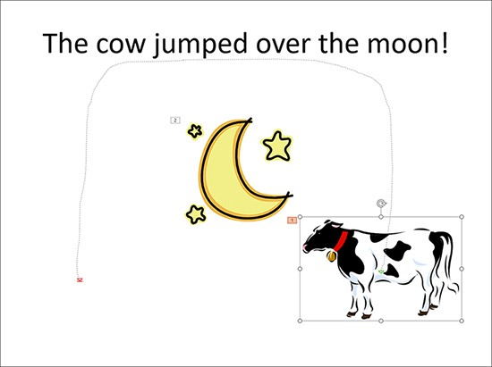
Using motion paths
Motion paths can emphasize objects in much the same way you use emphasis animation eﬀects such as the Spin and Underline eﬀects.
Motion paths can move an object in a circular, octagonal, or trapezoidal path.
A vertical ﬁgure-eight motion path even moves an object in a ﬁgure-eight pattern.
Motion paths do not necessarily have to move objects only in place on the slide. You can also use a custom motion path to relocate an object on a slide.
Select the object > Select a motion path in the Animation gallery (Lines, Arcs, or Loops) or select the More Motion Paths

Slide 48
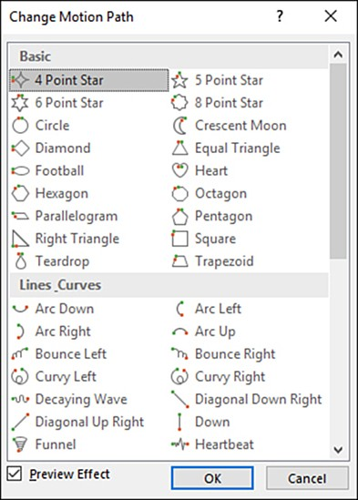
Applying motion paths
To assign a motion path to an object on a slide, select the object.
Then select a motion path in the Animation gallery, such as Lines, Arcs, or Loops.
If you want to access additional motion path animations, select the More Motion Paths command at the bottom of the gallery.
The Change Motion Path dialog box is divided into diﬀerent categories of paths:
Basic
Lines and curves
Special

Slide 49
Creating a custom motion path
To create a custom path, follow these steps:
Select the object to which you want to assign the custom path.
Navigate to the Animations tab and open the Animation gallery.
In the Motion Paths category of the gallery, select Custom Path.
Place the mouse pointer on the center of the object to which you want to assign the custom path.
Hold down the left mouse button, the mouse pointer becomes a drawing tool. Draw the custom path on the slide.
When you reach the endpoint for the custom motion path, double-click the mouse.
A preview of the custom path plays. You can preview any of the changes that you make to the custom path by selecting the Preview command.

Slide 50
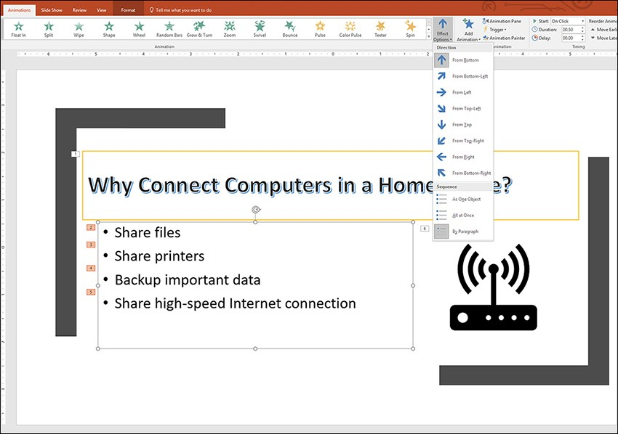
Changing eﬀect options
The Eﬀect Options command provides a gallery of options that relate to the type of animation eﬀect, meaning whether you have assigned an entrance, emphasis, or exit animation. To change the options for an animation eﬀect, select the object assigned the animation. Then select the Eﬀect Option command to access the options available for that eﬀect and object type.
Animations > Effect Options

Slide 51
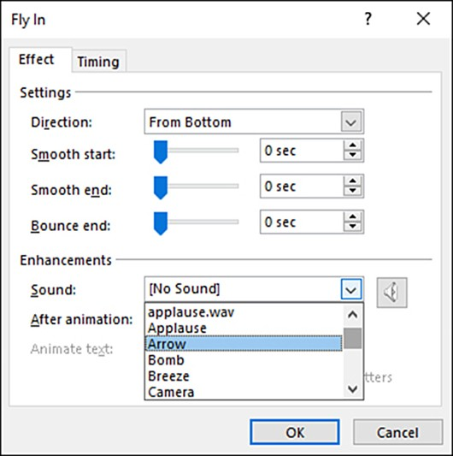
Including sound eﬀects with animations
To specify a sound for an animation, select the object assigned to the animation and then click the dialog box launcher under the Eﬀect Options command.
This opens a dialog box for the animation eﬀect assigned to the object. The Eﬀect tab of the dialog box controls settings related to the direction and the start and end of the animation.
The default sound setting for all animations that you have assigned to slide objects is No Sound.
When you select the Sound drop-down menu, you are presented with a list of sound ﬁles that can be applied to the animation.
Select the animated object > Effect Options > Select Sound

Slide 52
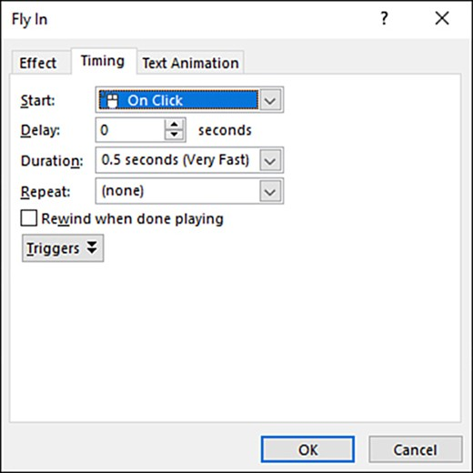
Setting timings for animations
You can set the timing for an animation using the commands available in the Timing group on the Animations tab.
The Start command enables you to set how the animation is started.
The default setting is On Click, but you can specify that the animation start with the previous animation (With Previous) or after the previous animation has ended (After Previous).
The Duration command provides a spin box that enables you to set the actual duration of the animation.

Slide 53
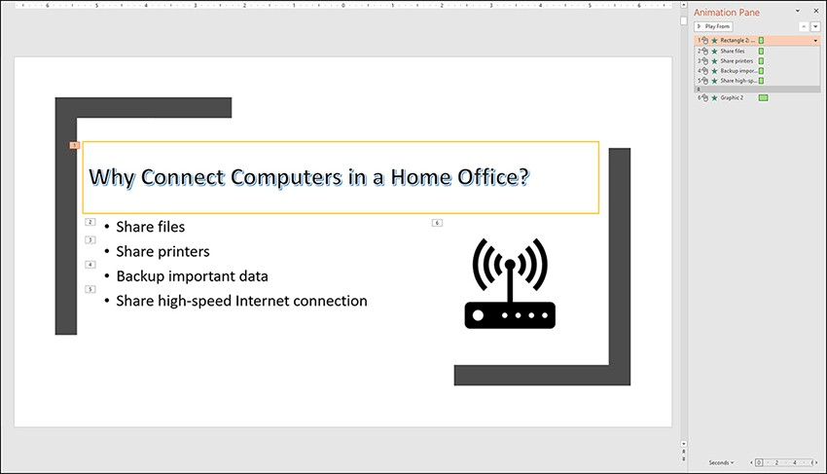
Managing slide animations
The Animation pane lists all the animations that have been assigned to objects on the current slide.
To open the Animation pane, select the Animation Pane command in the Advanced Animation group.
You can use the Animation pane to accomplish a variety of animation-management tasks, including reordering, deleting, and modifying animations.

Slide 54
Adding transitions to slides
A transition is a special eﬀect that provides a visual shift between slides rather than an abrupt cut or switch. The transition between the slides is triggered when you navigate from the current slide to the next slide (either by a click of the mouse or based on a timing), and that next slide has been conﬁgured with the transition. So, if you want a transition between slide A and slide B, you assign the transition to slide B. The ribbon’s
Transitions tab provides the command groups that enable you to select a transition, conﬁgure transition options, and conﬁgure sound and timing settings for a transition.

Slide 55
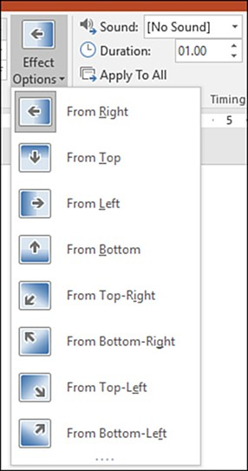
Modifying transitions
After you have assigned a particular transition in the gallery to a slide, you can modify the transition.
The Eﬀect Options command provides a gallery of options related to the transition you selected.
The options provided in the gallery are speciﬁc to the transition.

Slide 56
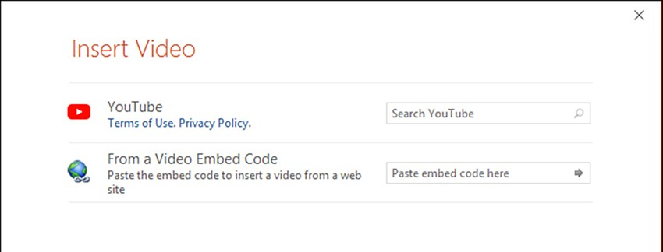
Adding video to a slide
To insert an online video clip into the current slide, you need to open the Insert Video window. You can open it by selecting Video and then Online Video on the ribbon’s Insert tab. You can also open the Insert Video window by selecting the Insert Video icon in a content area. You can insert video ﬁles from YouTube by searching YouTube directly from the Insert Video dialog box. When you locate the video that you want to insert into the current slide, select the video and then select Insert. The video is inserted into the slide. You can size the video and move it on the slide, as you require.
When the video frame is selected, the Video Tools appear on the ribbon.
Use the link for practicing: https://youtu.be/RvZdwTT2UKM

Slide 57
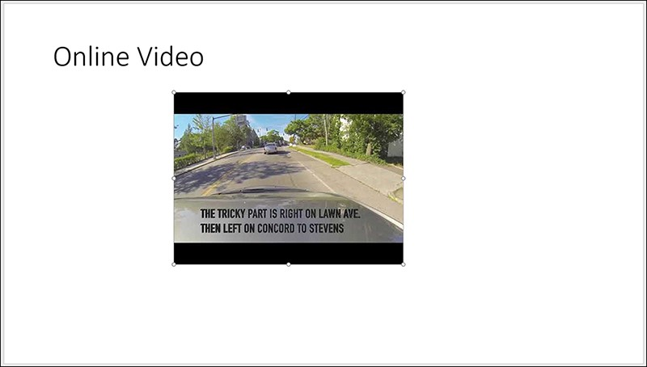

Adding video to a slide (cont.)
The Format commands are similar to the Format commands provided for pictures or shapes, they enable you to change the style of the video frame, including the shape and border. Useful commands are provided on the Format tab, in the Adjust group. You can correct the brightness and contrast of the video using the Corrections command. You can also colorize the video using the Color command.

Slide 58
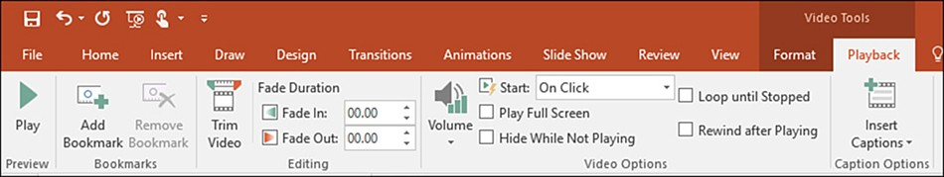
Modifying your video clips
The Video Tools consist of two tabs: Format and Playback.
The Format tab has many similarities to the Format tab of the Picture Tools and can be used to modify the frame, correct brightness/contrast issues, and change the color of the video.

Slide 59
Delivering a presentation
and creating support materials

Slide 60

Checking the presentation for spelling and grammar errors
Grammar checking in PowerPoint is not enabled by default, but you can enable it in the PowerPoint Options window.
Select File and then, in the Backstage, select Options. The PowerPoint Options window opens.
Select Prooﬁng to access the spelling and grammar settings.
File > Backstage > Options > Proofing

Slide 61

Running through a completed presentation
The Slide Show tab of the ribbon provides all the commands you need to run through your presentation. A Present Online command even allows you to show your presentation via the web.
The Slide Show tab provides commands to create custom slideshows, hide slides in a presentation, and record slideshow timings for a self-running show. The Start Slide Show group on the Slide Show tab provides two commands for starting the slideshow. The From Beginning command and the From Current Slide command operate exactly as advertised.

Slide 62

Using hidden slides
The Hide Slide command is housed on the ribbon’s Slide Show tab in the Set Up group.
You can hide a slide or slides when you are working in Normal view or in the Slide Sorter.

Slide 63

Setting up a slideshow
You can specify settings for a slideshow, including the show type, the slides shown during the slideshow, the selection of a custom show, and other options related to the slideshow, such as how the slides are advanced and whether you want to use the Presenter view (for a presentation given by a speaker).
You open the Set Up Show dialog box by selecting the Set Up Slide Show command in the Set Up group.

Slide 64

Recording a slideshow
You can also record a slideshow that has the timings for the slides and animations and includes recorded narration and laser pointer actions.
The Record Slide Show command enables you to record the slideshow from the beginning or from the current slide.
Slide Show > Record Slide Show

Slide 65

Working with the notes and handout masters
To access the Handout Master, select the Handout Master command on the View tab. The Handout Master tab provides the following groups:
Page Setup
Placeholders
Edit Theme
Background
Close
View tab > Handout Master

Slide 66
Setting notes master options
To access the Notes Master from the View tab, select Notes Master. The Notes Master tab appears on the ribbon.
The Notes Master tab provides the same command groups provided by the Handout Master tab.
You can use the Page Setup commands to change the page setup and also to change the page and slide orientation.
The Placeholders group has a number of check boxes that enable you to determine what appears in the header and footer areas on the page, such as the date and page number.
Also, you can manipulate the slide and notes text box on the Notes Master. For example, if you want the slide to take up less space on the master, you can select the slide box and resize or move the slide as needed.
You can then expand the notes area.
By default, the master text box is conﬁgured to include a ﬁve-level outline.
You can select the text in the master text box and then change it using the various font and paragraph commands available on the Home tab.
You can also select the Format tab of the drawing tools (which appears when you select the text box) and change any desired settings.
When you ﬁnish setting the options for the notes master, click Close Master View on the Notes Master tab.

Slide 67


Printing presentations, notes, and handouts
Printing these various items is accomplished from the PowerPoint Backstage.
To access the Backstage, select File on the ribbon. To access the Print window, select Print.

Slide 68

Exporting a presentation
PowerPoint provides some other for exporting your presentation ﬁle. For example, you can create an Adobe Acrobat (PDF) version of the slide presentation, which makes it easy to email or post your presentation on a website (a PDF also makes it easy to print the entire presentation).
Other Export options include creating a video of the presentation and packaging the presentation for a CD.
The PowerPoint Export tools are accessed in the Backstage; select File and then Export.

Slide 69

Sharing your presentation
You can collaborate with colleagues and coworkers as you build your PowerPoint presentations. Multiple users can edit a PowerPoint presentation in a networking environment that supports the sharing process.
You can share presentations on your OneDrive or on a SharePoint server (available if you subscribe to Oﬃce 365 or work at a company that hosts a SharePoint site).
You can also share a presentation via email as an attachment.
The Share page in the PowerPoint Backstage provides diﬀerent strategies for sharing your presentation ﬁles with other users.

Slide 70
Useful links
https://www.youtube.com/watch?v=Fl2lYiRPsVc
PowerPoint 2021 Full Course Tutorial

Slide 71
Thank you for your attention!

